Slide 2
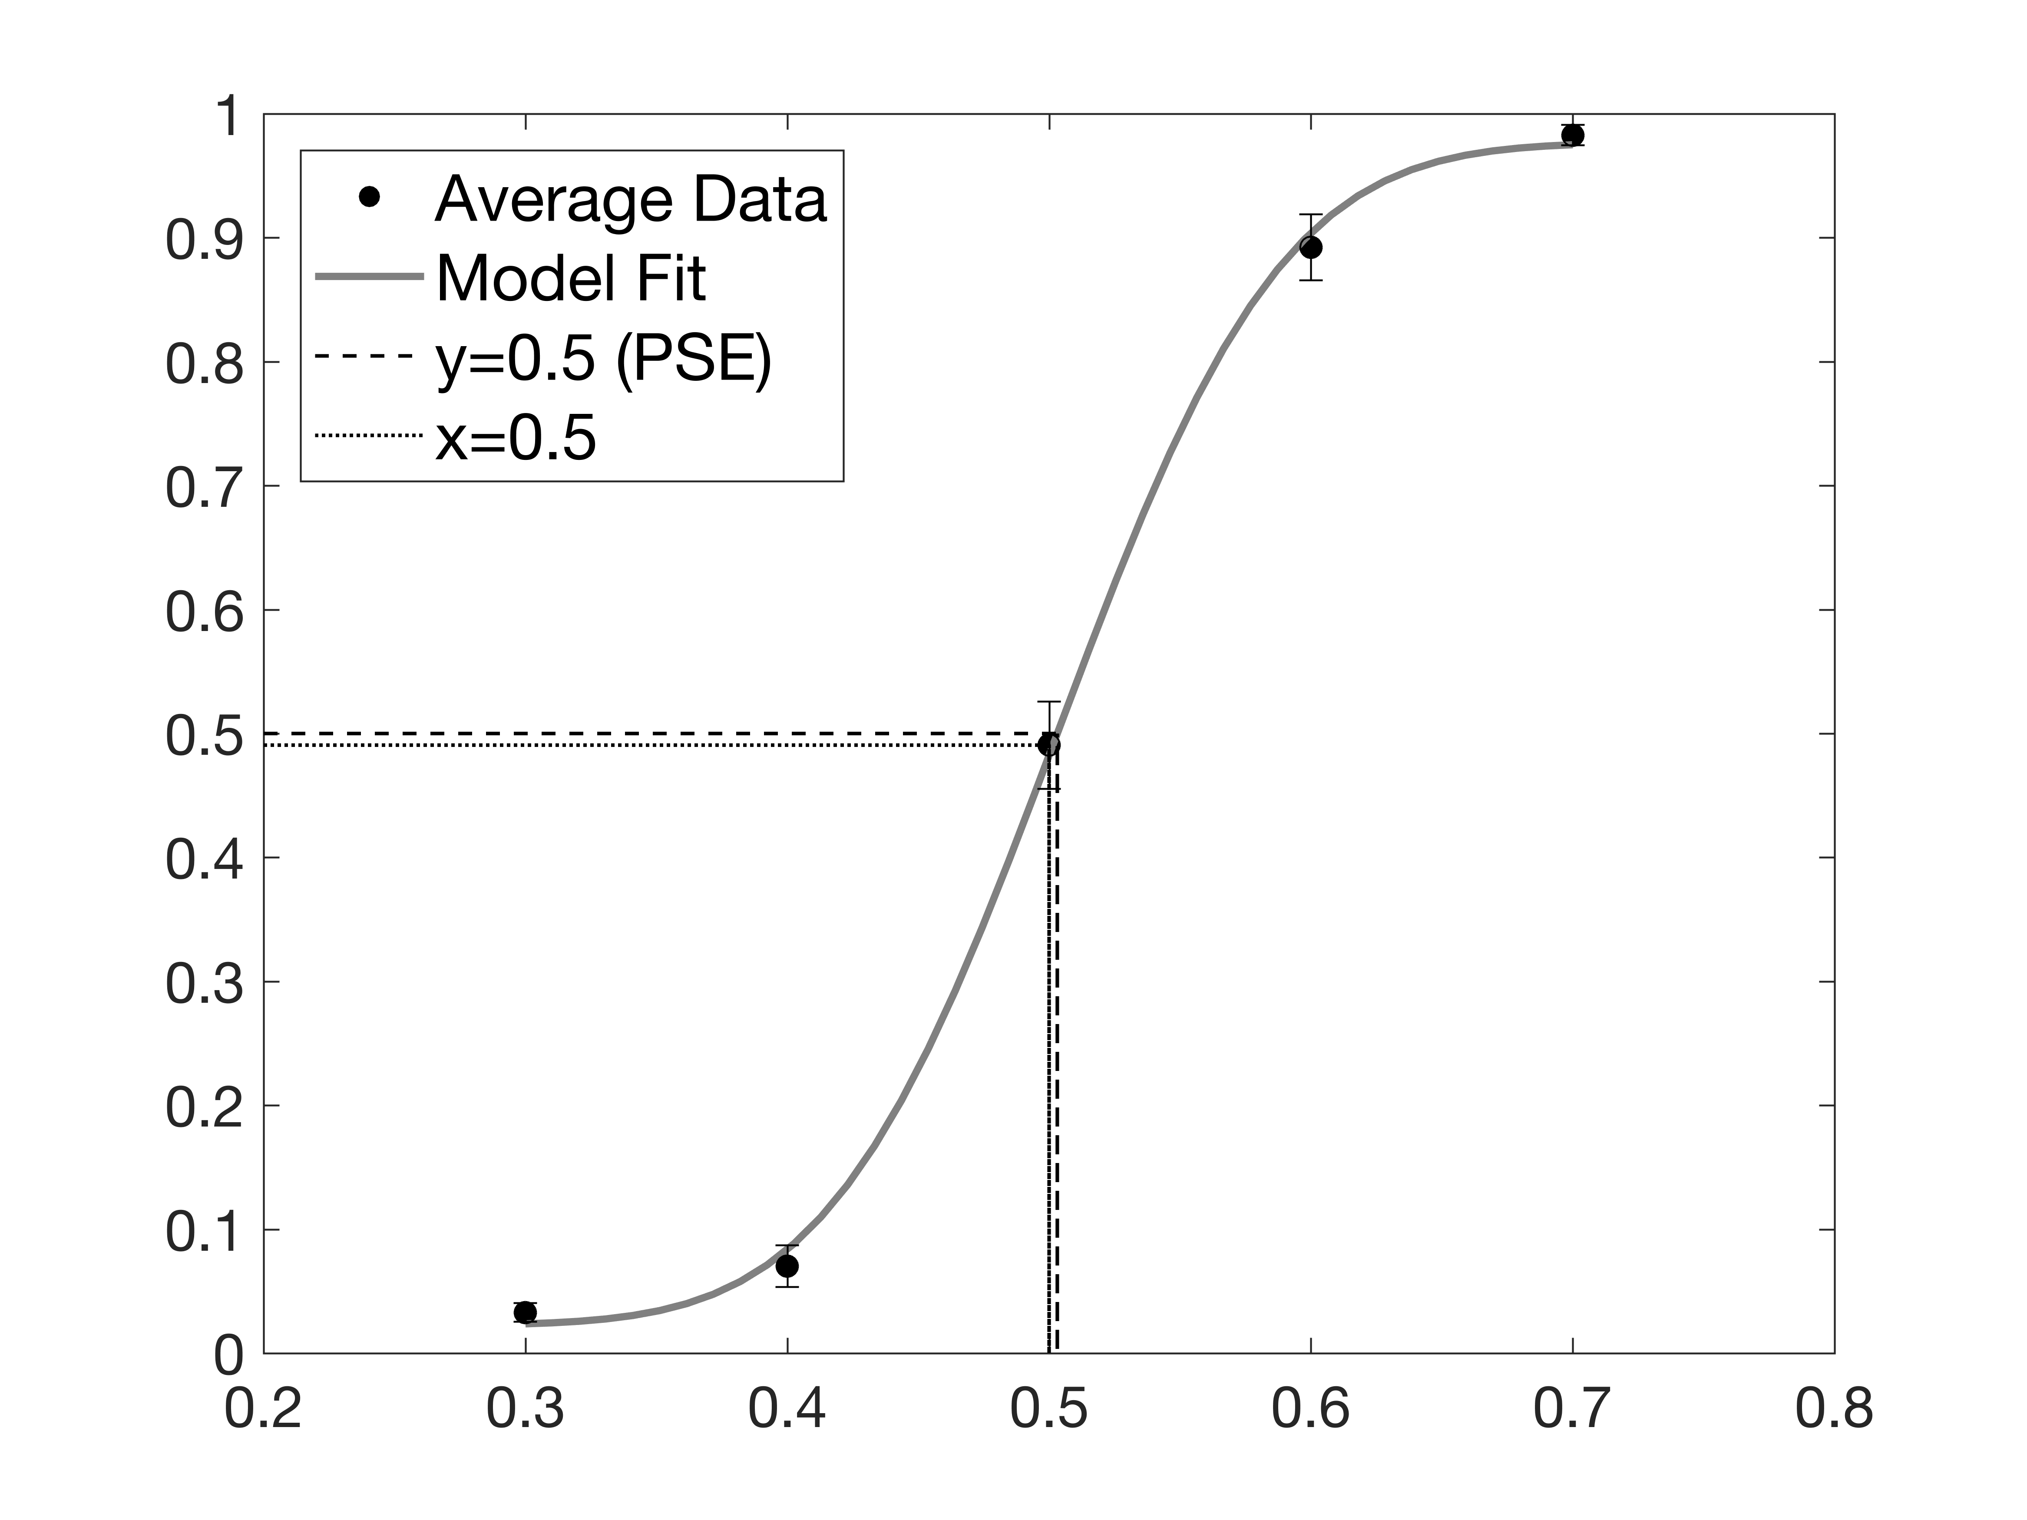
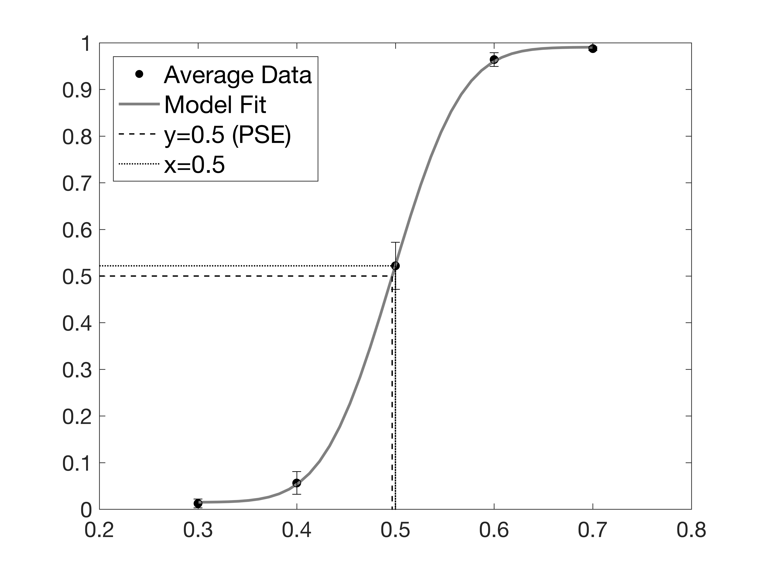
Experiment 2 (Expt 1 in manuscript)
A
B
Proportion Chosen Saturation Periphery > Center
Proportion Chosen Saturation Periphery > Center
Saturation in Periphery
Saturation in Periphery
c
Notes:
Experiment 4

Slide 3

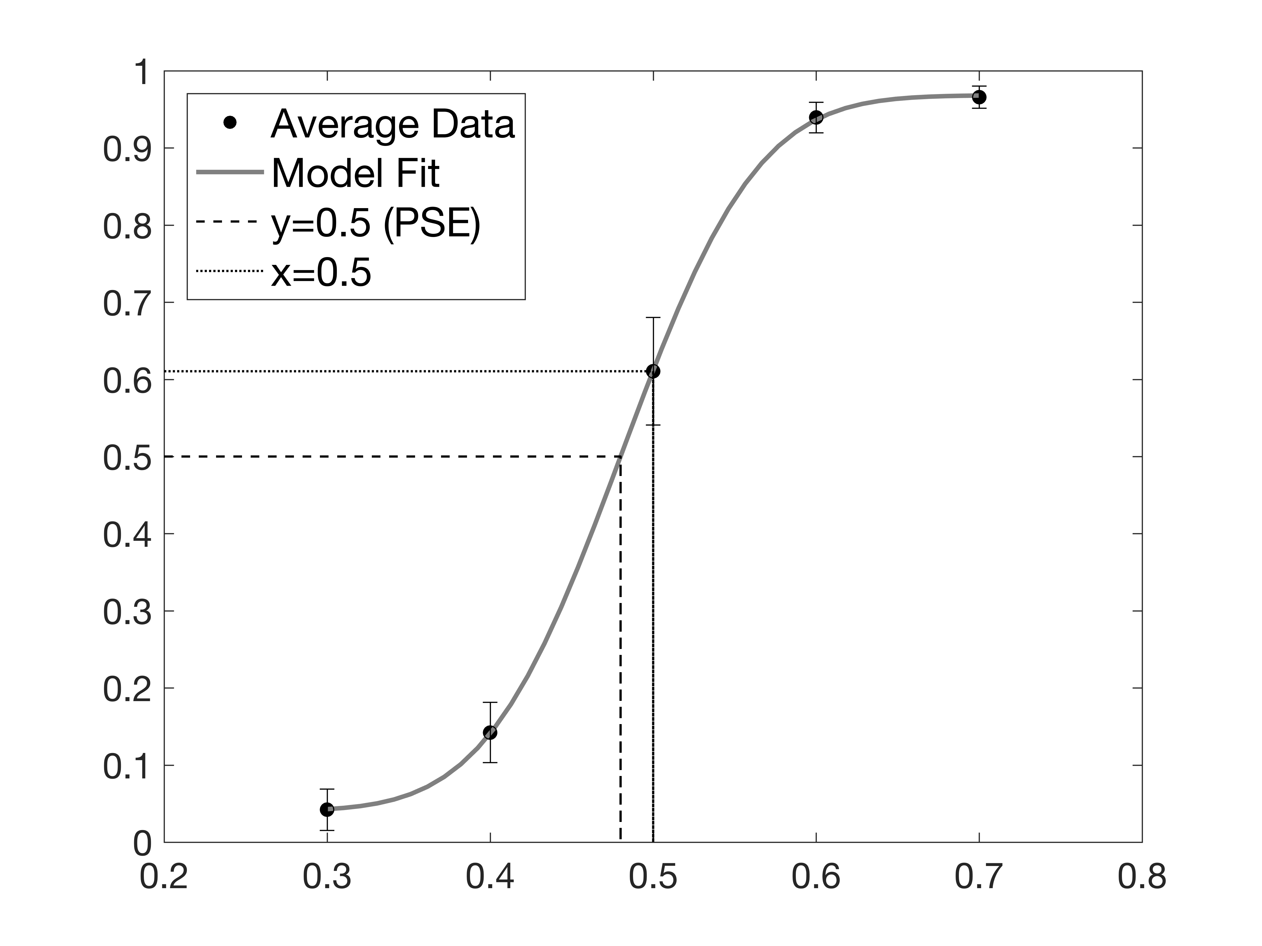
Experiment 3_2 (Expt 2 in manuscript)
A
B
Proportion Chosen Saturation Periphery > Center
Proportion Chosen Saturation Periphery > Center
Saturation in Periphery
Saturation in Periphery
c
Notes:
Experiment 4

Slide 4
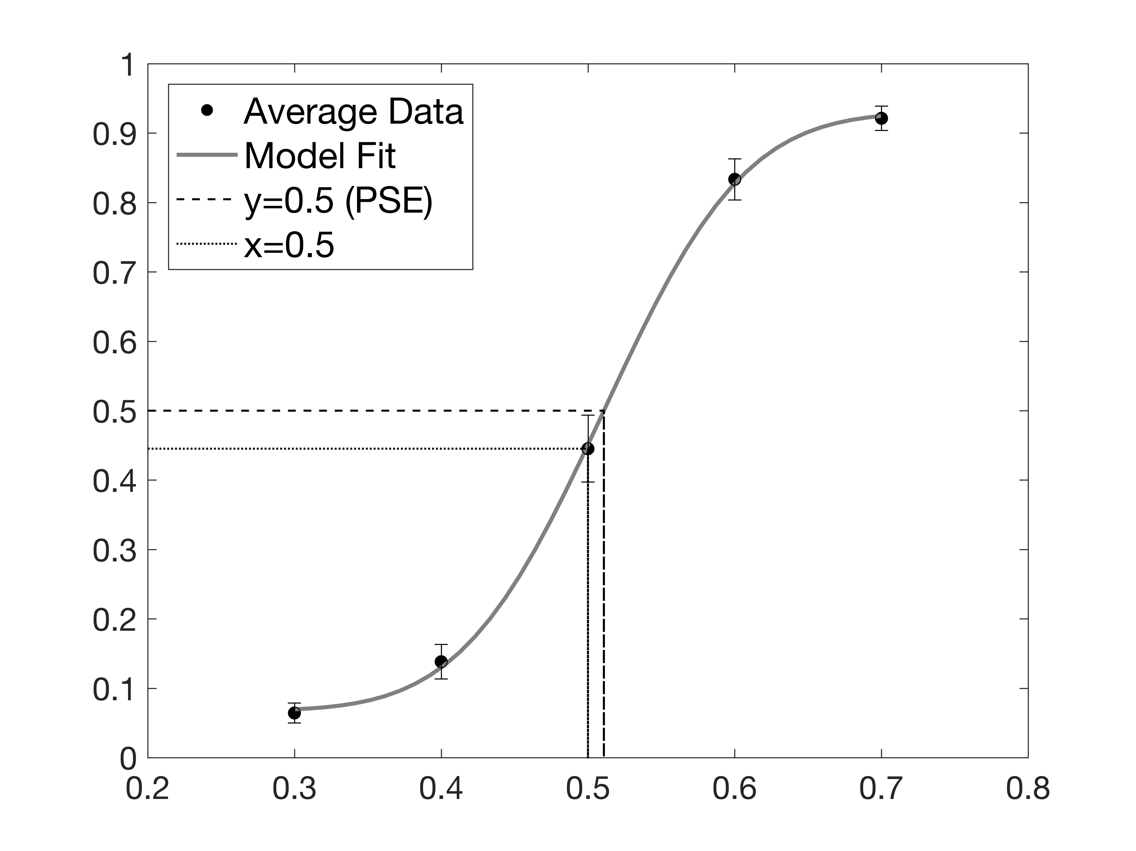

Experiment 4 (Expt 3 in manuscript)
A
B
Proportion Chosen Saturation Periphery > Center
Proportion Chosen Saturation Periphery > Center
Saturation in Periphery
Saturation in Periphery
c
Notes:
Experiment 4

Slide 5
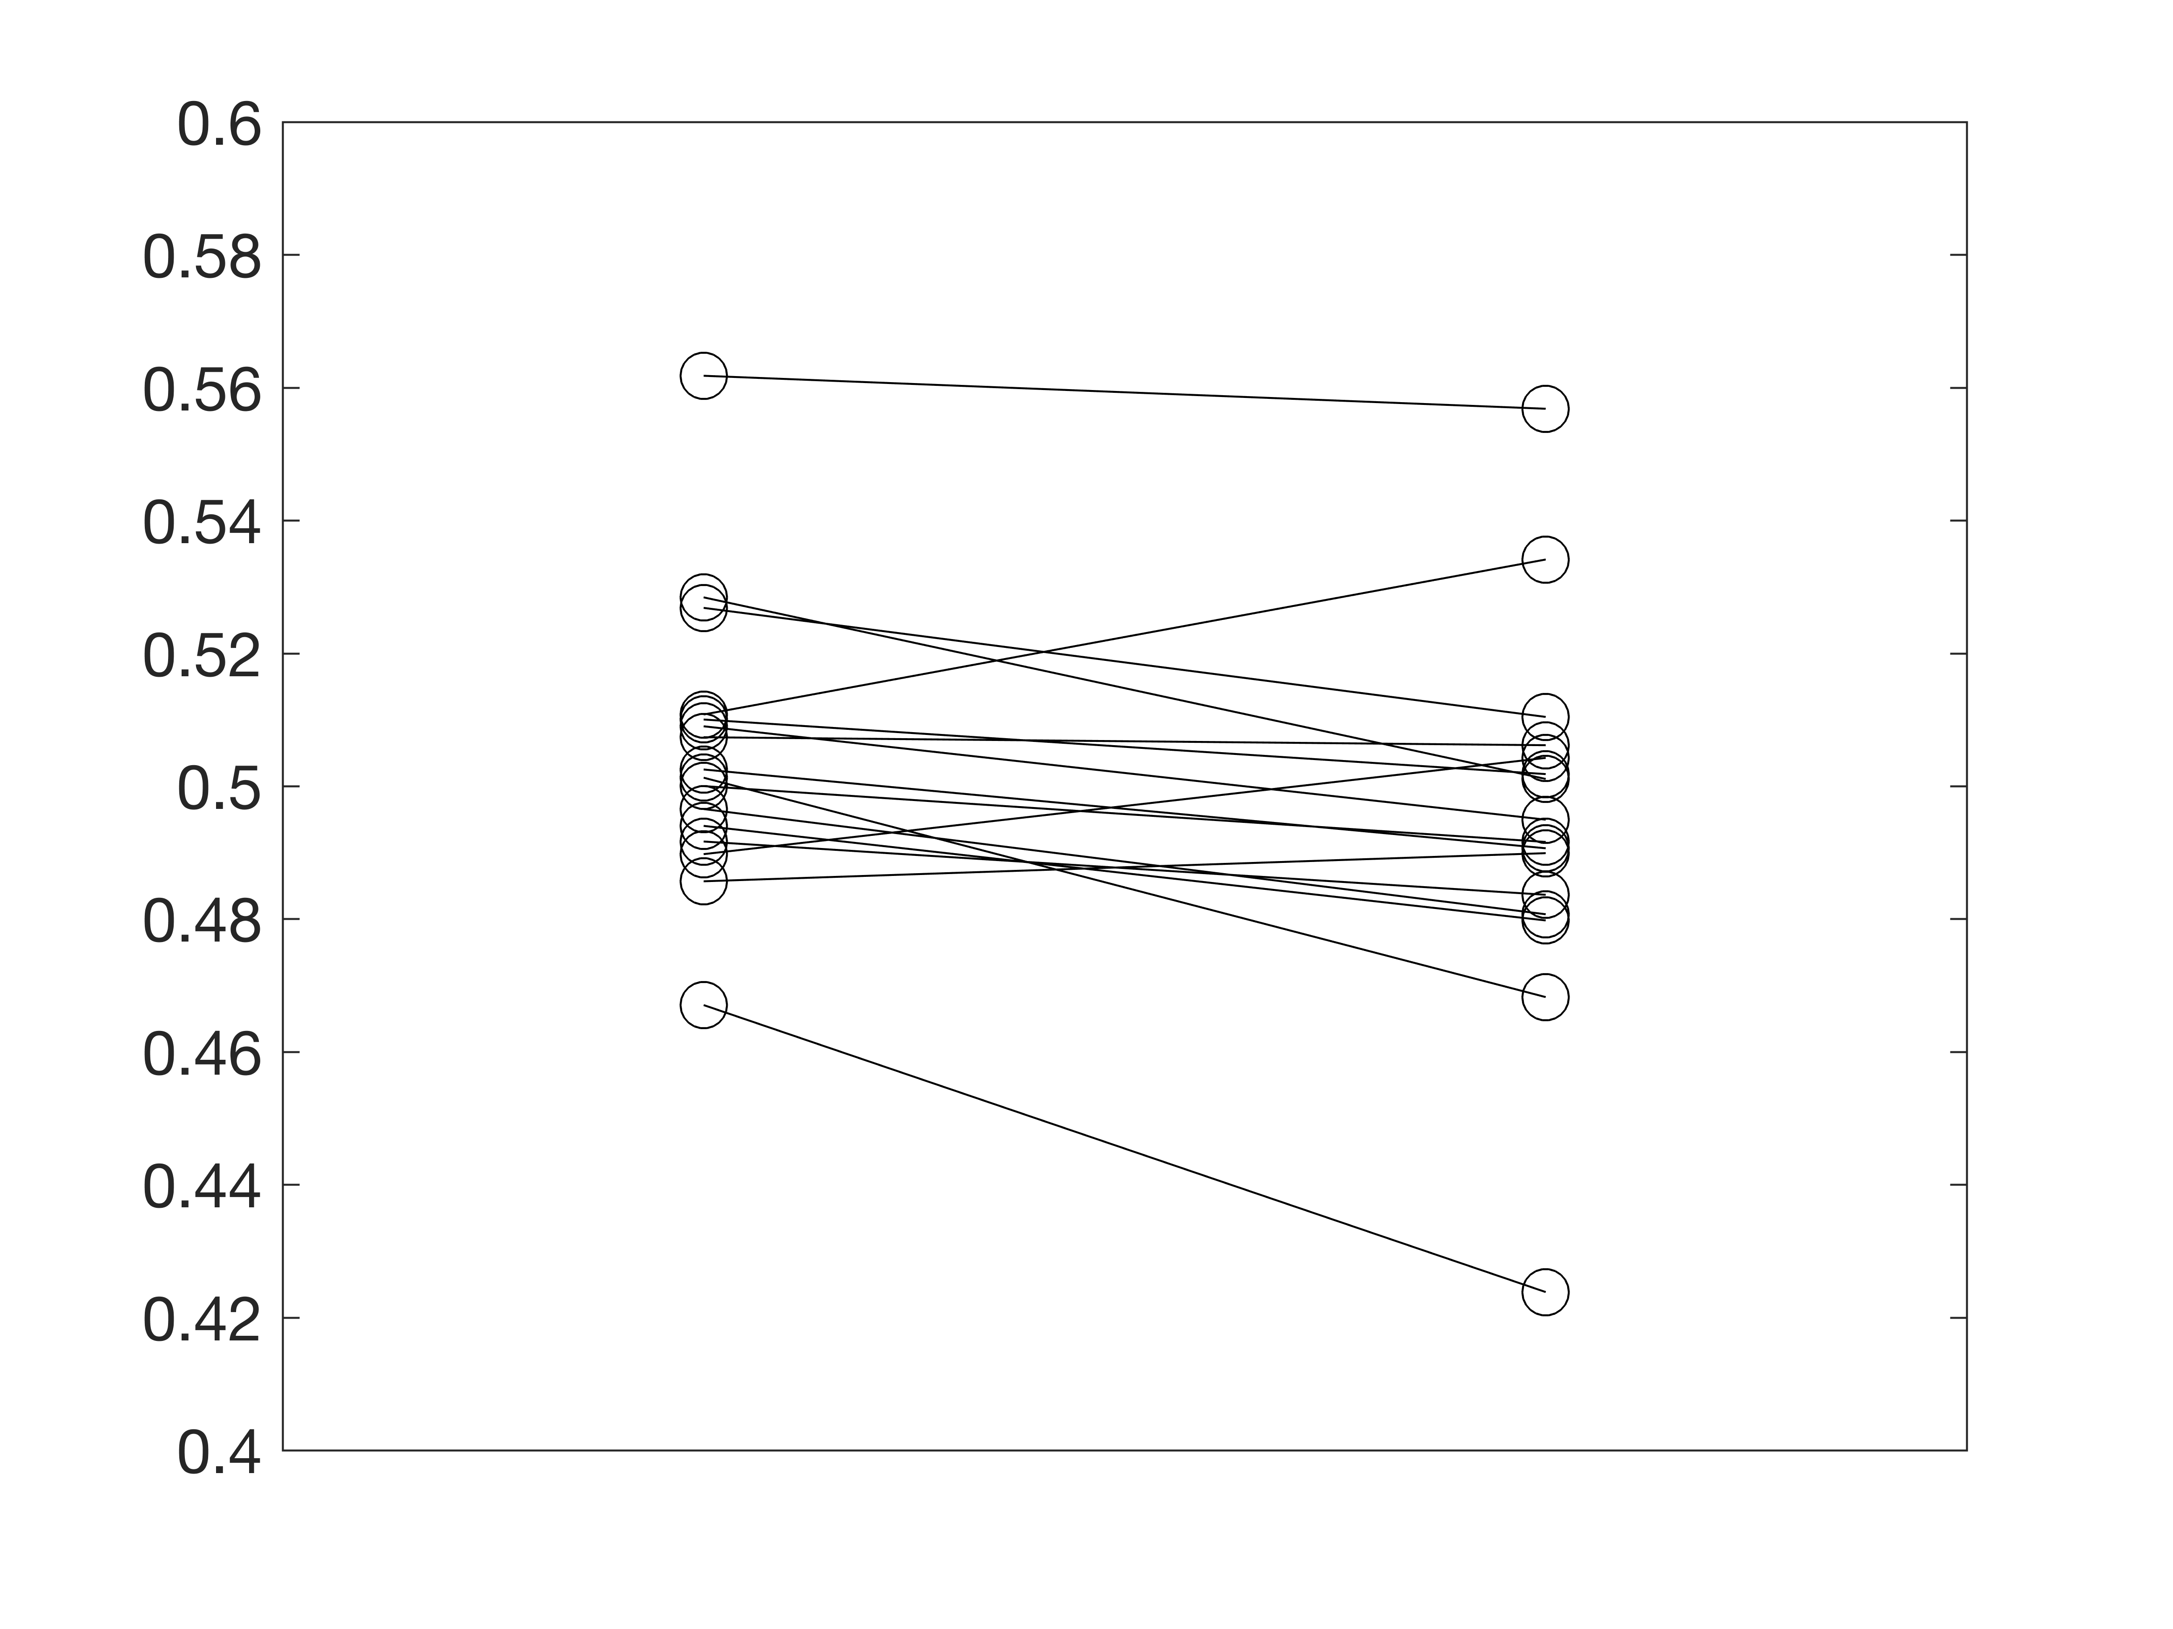
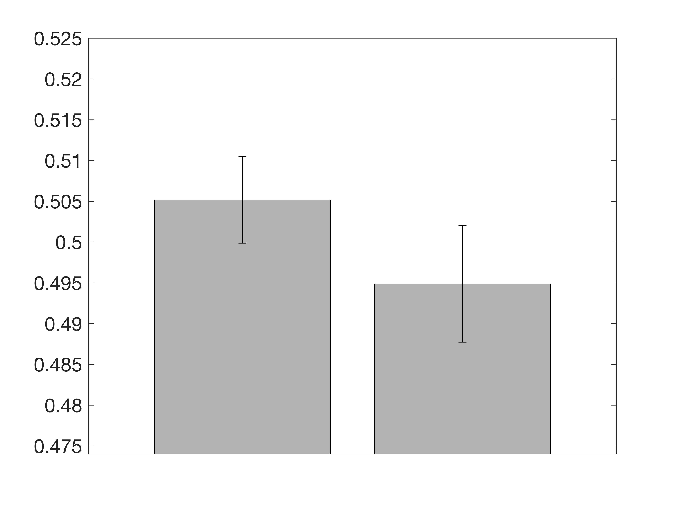
Experiment 2 (Expt 1 in manuscript)
A
B
Point of Subjective Equality (PSE)
Point of Subjective Equality (PSE)
1-flash 10-flash
1-flash 10-flash
c
Notes:
Experiment 2

Slide 6
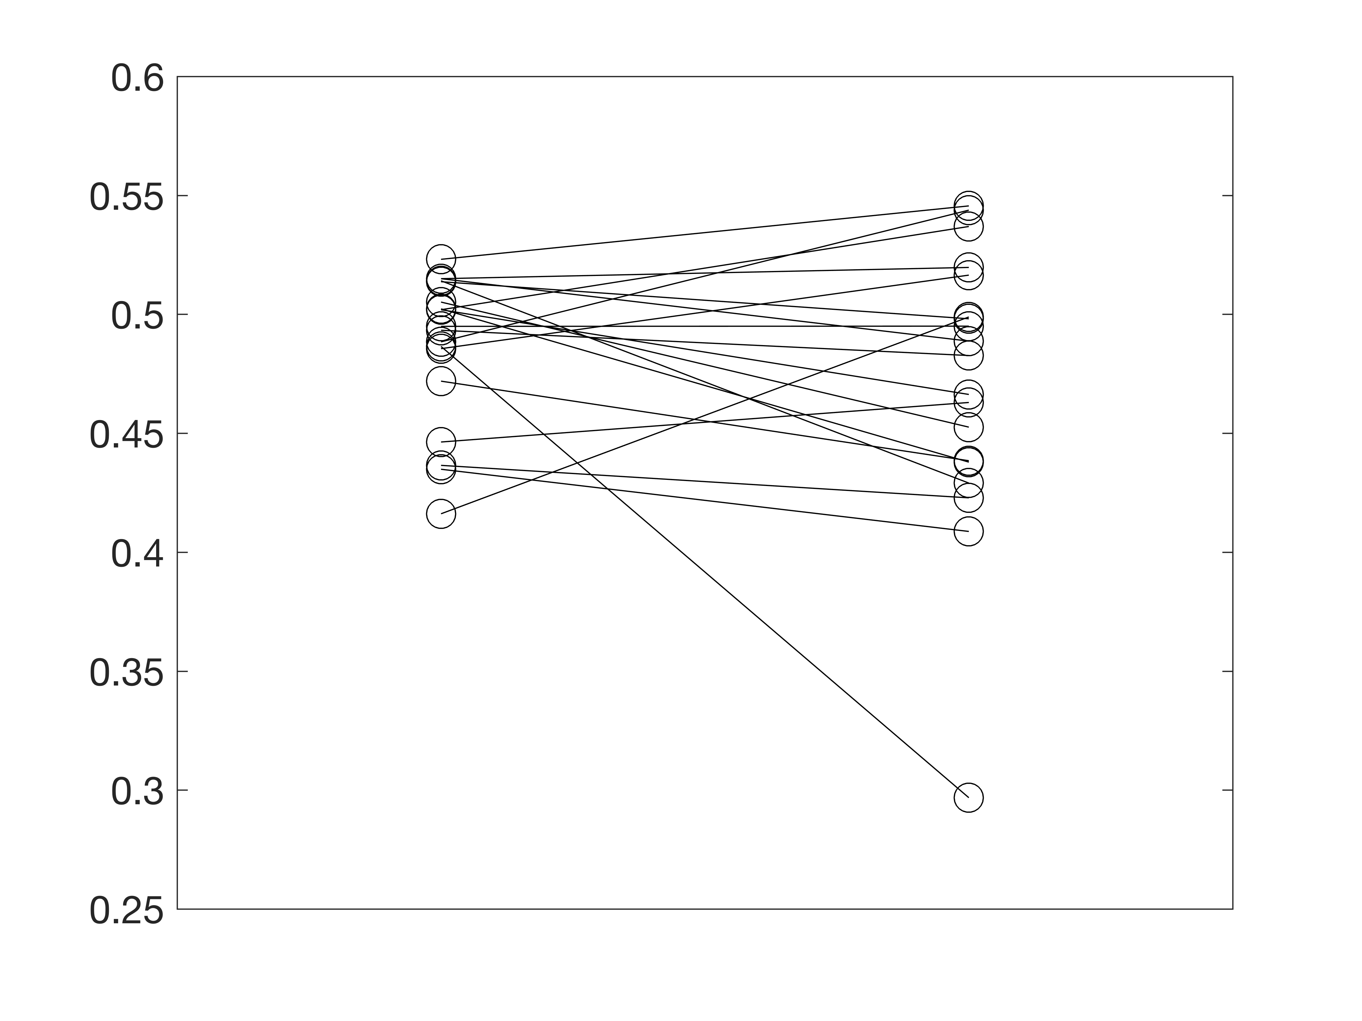
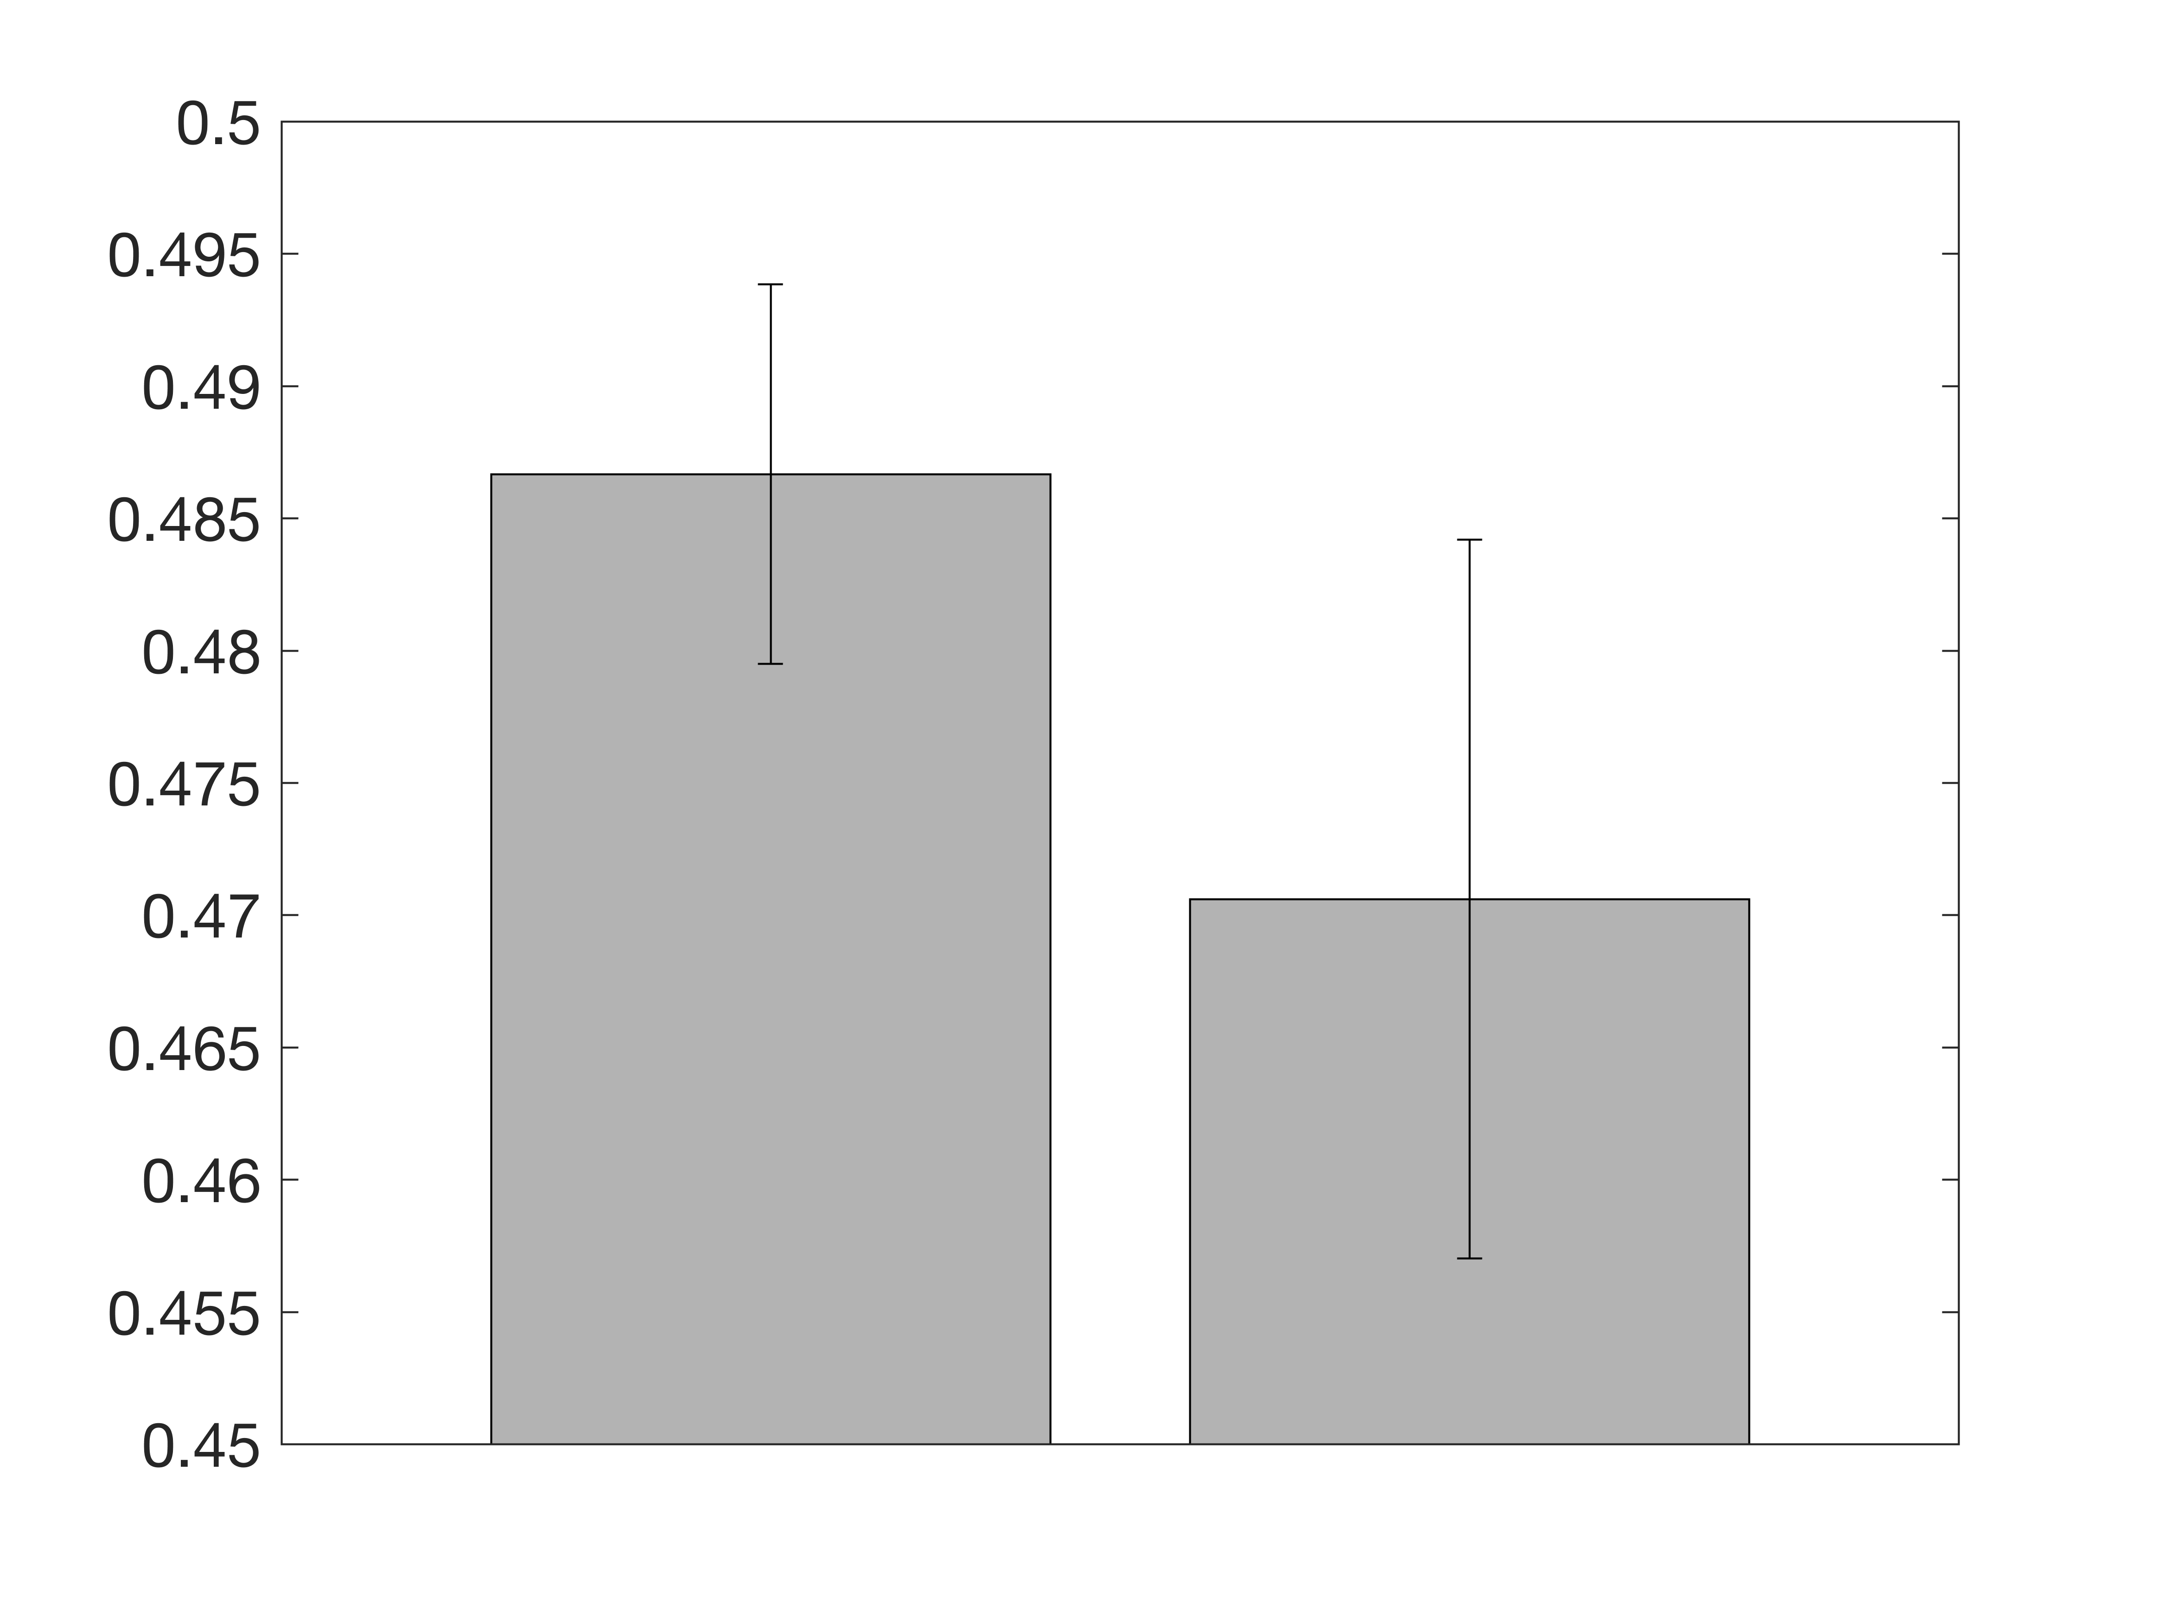
Experiment 3_2 (Expt 2 in manuscript)
A
B
Point of Subjective Equality (PSE)
Point of Subjective Equality (PSE)
Gray Real-World
Gray Real-World
Notes:
Experiment 3_2

Slide 7
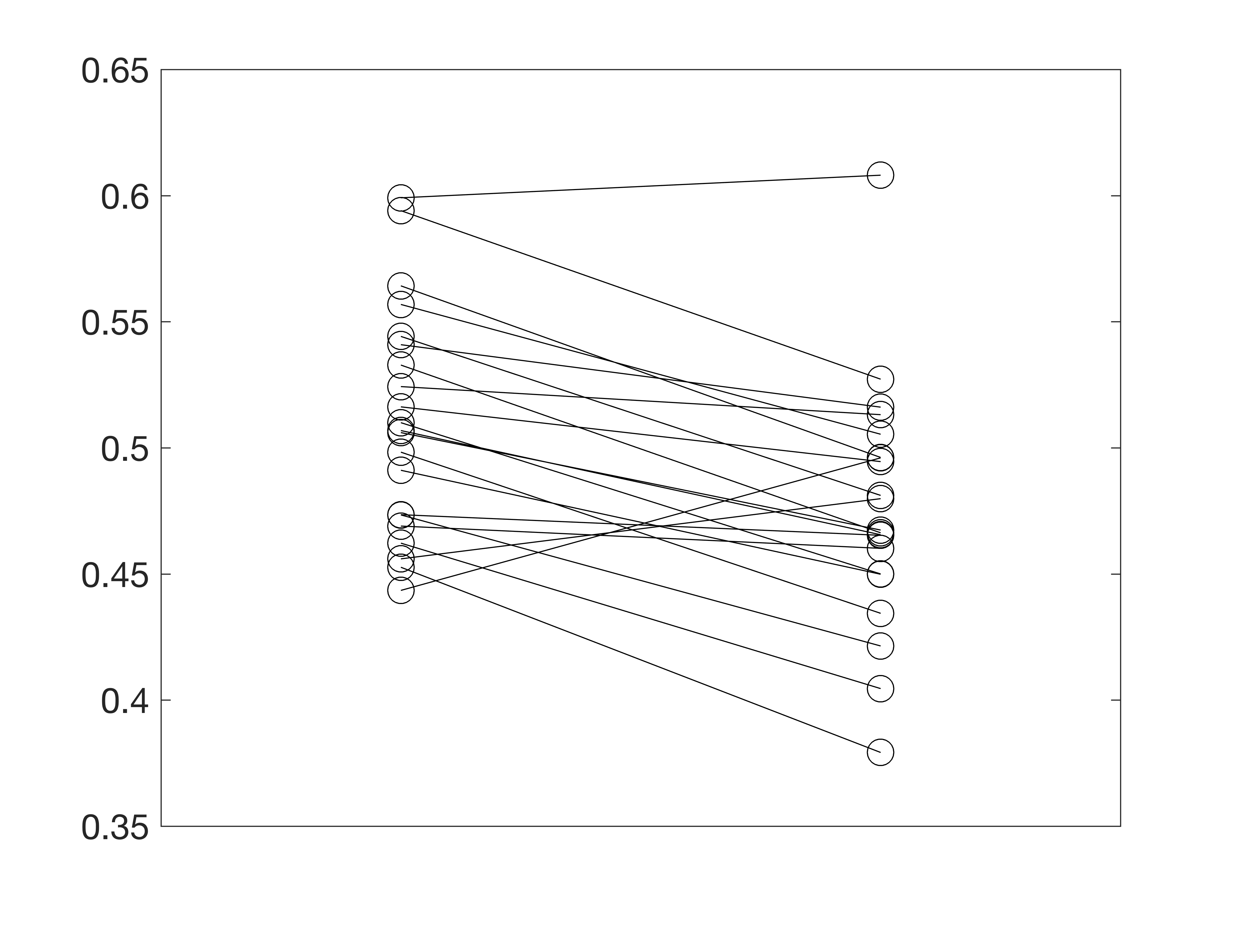
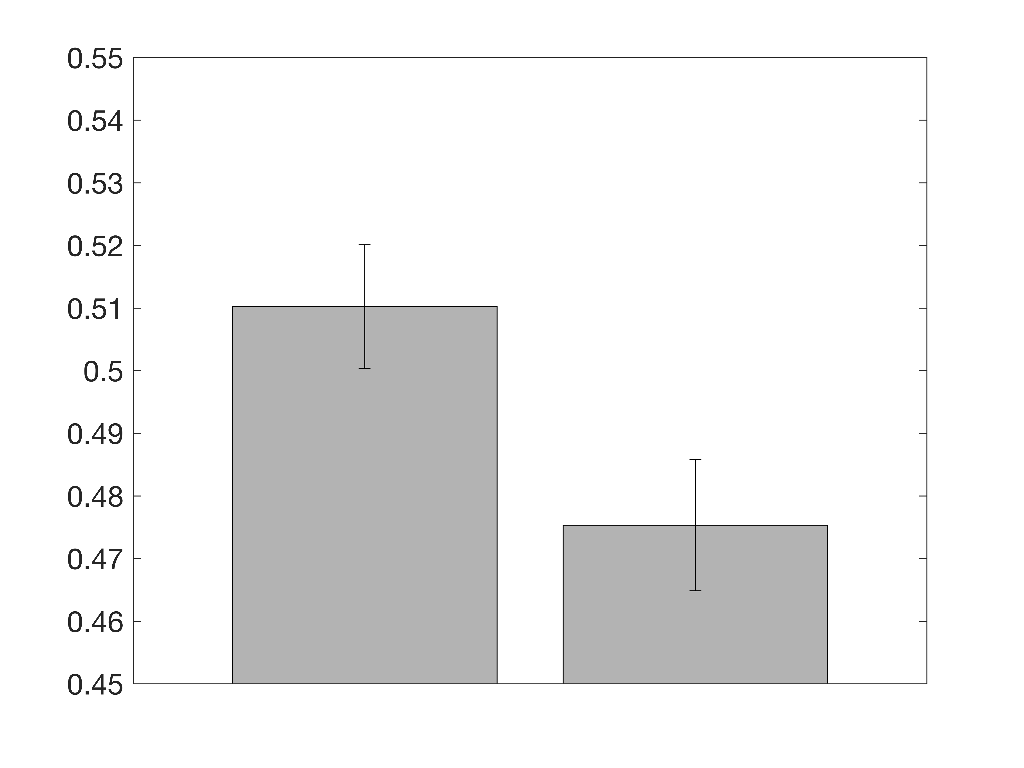
Experiment 4 (Expt 3 in manuscript)
A
B
Point of Subjective Equality (PSE)
Point of Subjective Equality (PSE)
1-flash 20-flash
1-flash 20-flash
Notes:
Experiment 4

Slide 8
Which patch was more colorful?
Press C if the center was more colorful.
Press P if the sides were more colorful.

